Slide 1

Image Processing Techniques
Point Processing, Intensity Transformations & Histogram Processing
Based on the textbook by
Dr. Ahmed Yousry
Digilians

Slide 2



Point-Wise Intensity Transformations
What is Point Processing?
Three Core Categories
Point processing modifies the intensity of each individual pixel in an input image based purely on its current value, independent of surrounding pixel neighborhoods.
Transformation functions generally fall into three basic mathematical profiles:
→
Linear: Image Negatives (S = L - 1 - r).
→
Logarithmic: Compression of dynamic range to reveal hidden shadow details.
Where r is the input pixel intensity, s is the output pixel intensity, and T is the mapping function.
→
Power-Law: Gamma Correction curves for displaying images accurately on screens.

Slide 3
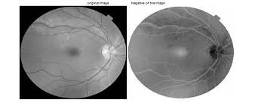
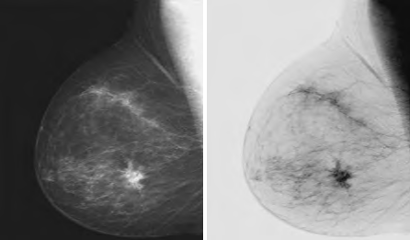
Negative Transformation
Inverting Intensity Levels
An image negative reverses the intensities of a digital image within the operational range [0, L-1].
Dark features become light, and light details become dark.
Primary Application
Extensively used in medical visualization (such as Mammography or chest X-rays) to emphasize gray-level anomalies or subtle structural boundary changes.

Slide 4


Logarithmic Transformations
Compressing Dynamic Range
Log transformations are crucial when the range of intensity values in the raw input is extremely wide, such as Fourier transform spectra.
Implementation Model
In Python, the scaling factor is typically calculated dynamically to ensure the output utilizes the full gray-level scale [0, 255]:
By mapping a narrow range of low-intensity values into a wider output range, it significantly highlights fine details lost in the dark regions of an image.

Slide 5
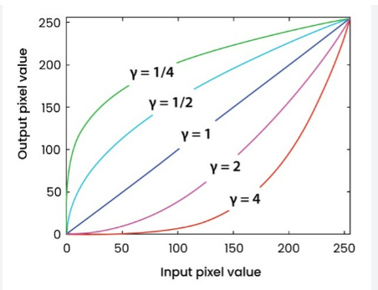
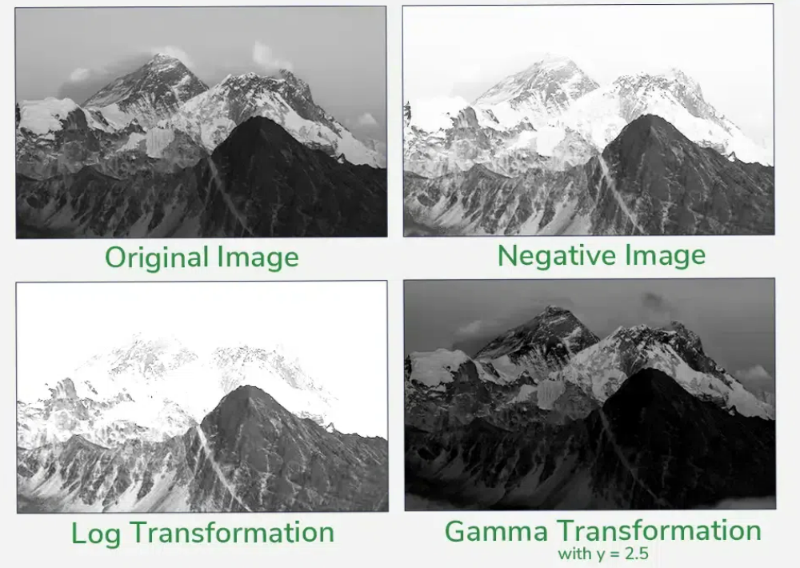
Gamma Correction
The Power-Law Relationship
Gamma transformations mathematically scale contrast using exponent values, adjusting dark and light zones in a non-linear fashion.
Impact of Exponent gamma
If , the map expands dark details.
If , it expands bright details instead. This is vital for displays.

Slide 6

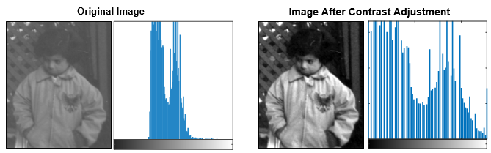

Contrast Stretching
Piecewise Linear Enhancements
Contrast stretching is a normalization technique that spreads low-contrast images to span the full dynamic range of a display device.
Useful for microscopic images or poorly illuminated outdoor environments where lighting is uniform but weak.

Slide 7



Image Binarization
Binary Transformation
Practical Applications
Thresholding converts a grayscale image into a binary output (containing only 0 and 1, or 0 and 255) by dividing pixel levels around a chosen threshold .
Binarization isolates objects of interest from their background, forming the absolute foundation for:
→
Optical Character Recognition (OCR): Separating text characters from scanned document sheets.
→
Segmentation: Isolaing organs/artifacts in medical diagnostic imaging.
→
Morphological Preprocessing: Preparing clean binary silhouettes for structural analysis.

Slide 8





Histogram Processing Concepts
What is a Histogram?
Probability Theory
Utility in Vision
A discrete function representing the distribution of pixel values across an image. Mathematically counts instances of each gray value.
Normalizing a histogram divides counts by total pixels, estimating the probability of occurrence for each gray-level range.
Allows models to quickly analyze global illumination, diagnose contrast errors, and balance dynamic ranges algorithmically.

Slide 9

Histogram Equalization
The Equalization Objective
Algorithmic Step-by-Step
Histogram Equalization transforms the original gray-levels so that the resulting output image possesses a uniform probability distribution.
→
Compute Histogram: Sum frequencies of each intensity level.
→
Calculate CDF: Obtain the Cumulative Distribution Function by summing running totals.
This effectively "spreads out" high-frequency intensity clusters, producing a flat histogram and maximizing global contrast.
→
Normalize & Round: Scale and round the cumulative value to the nearest integer level.
→
Map Intensities: Use the generated table as a lookup array to update all pixel coordinates.

Slide 10
Mathematical Equalization Example
Old Intensity (r_k) | Pixel Freq (n_k) | Cumulative Sum (T(r_k)) | Normalized Output (G(r_k)) | Rounded New Intensity
0 | 4 | 4 | 7/32 * 4 = 0.875 | 1
1 | 8 | 12 | 7/32 * 12 = 2.625 | 3
2 | 8 | 20 | 7/32 * 20 = 4.375 | 4
3 | 4 | 24 | 7/32 * 24 = 5.250 | 5
4 | 8 | 32 | 7/32 * 32 = 7.000 | 7
Step-by-step mapping of a 5-level grayscale image with total pixels n=32 to a target output dynamic range of L=8, levels (0-7).

Slide 11
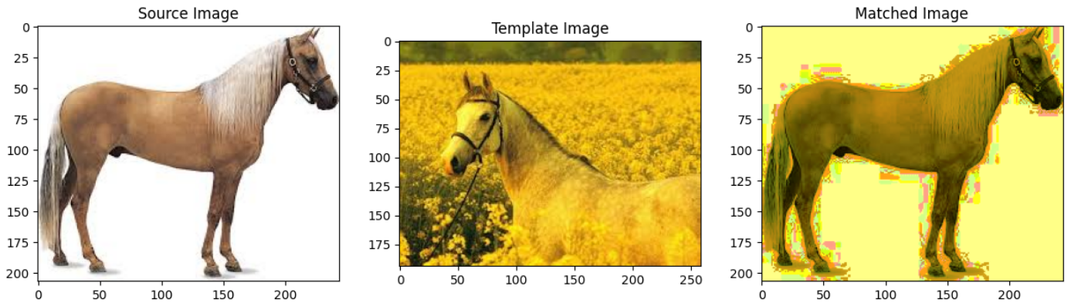
Histogram Matching
Target Histogram Alignment
Unlike equalization, which forces a uniform output, Histogram Matching maps an image's pixel values to mimic a specific target reference distribution.
This is highly effective for preparing multi-source satellite images or aligning camera exposures under changing lighting conditions.
→
Compute equalization profiles for both source and target.
→
Inverse-map the source states to corresponding target states.
→
Apply generated lookup table to transform original image.

Slide 12




Image Sources
→
https://www.frontiersin.org/files/Articles/1672569/xml-images/frsip-05-1672569-g011.webp
Source: www.frontiersin.org
→
https://media.geeksforgeeks.org/wp-content/uploads/20240710150104/Basic-Intensity-Transformation-Function-Gamma-Correction-1.webp
Source: www.geeksforgeeks.org
→
https://www.mdpi.com/plants/plants-13-02140/article_deploy/html/images/plants-13-02140-g001-550.jpg
Source: www.mdpi.com
→
https://dfzljdn9uc3pi.cloudfront.net/2024/cs-2121/1/fig-7-2x.jpg
Source: peerj.com

